Slide 1
15ECSW301: MINI PROJECT
PROJECT TITLE: HATEFUL MEMES CHALLENGE
GUIDE : Shankar G
Team 5:
Abhishek Rao : 01fe18bcs297
Varun Bohara : 01fe18bcs278
Sakshi tahlani : 01fe18bcs271
Madhurika Ganiger:01fe18bcs284

Slide 2
Problem Statement
Given an internet meme, our model should predict whether a meme is hateful or non-hateful.
This is a binary classification problem with multimodal input data consisting of the meme image itself (the image mode) and a string representing the text in the meme image (the text mode).

Slide 3
Overview:
In this work we target the problem of hate speech detection formed by a text and an image.
We analyze a large scale dataset from DataDriven and propose different models that jointly analyze textual and visual information for hate speech detection.
Motivation:
Social Media platforms such as Facebook, Twitter or Reddit have empowered individuals’ voices and
facilitated freedom of expression. However they have also been a breeding ground for hate speech and
other types of online harassment.
Hate speech can be defined as “A direct or indirect attack on people based on characteristics, including
ethnicity, race, nationality, immigration status, religion, caste, sex, gender identity, sexual orientation, and
disability or disease. We define attack as violent or dehumanizing (comparing people to non-human
things, e.g. animals) speech, statements of inferiority, and calls for exclusion or segregation. Mocking
hate crime is also considered hate speech.
This definition mirrors the community standards of hate speech employed by Facebook, and is intended to
provide an actionable classification label: if something is hate speech according to this definition, it
should be taken down; if not, even if it is distasteful or objectionable, it is allowed to stay. Through this
work, we aim to create an algorithm for multimodal hate speech in internet memes.

Slide 4
Objectives of the project:
The objectives of the work are as follows:
• We propose the novel task of hate speech detection in multimodal publications, collect, annotate and publish a large scale dataset.
• We evaluate state of the art multimodal models on this specific task and provide the hate score.
• We aim to build a Graphical user interface for our model.
• We study the challenges of the proposed task, and open the field for future research.

Slide 5
Exploring Hate Speech Detection in Multimodal Publications
Raul Gomez , Jaume Gibert , Lluis Gomez , Dimosthenis Karatzas, WACV 2020
Target : Problem of Hate Speech detection in multimodal publications
Even though images are useful for the hate speech detection task, current multimodal models cannot outperform models analyzing only text and discuss Why.
MMHS150K –
Gathered : Twitter API
Annotated : Amazon Mechanical Turk.

Slide 6
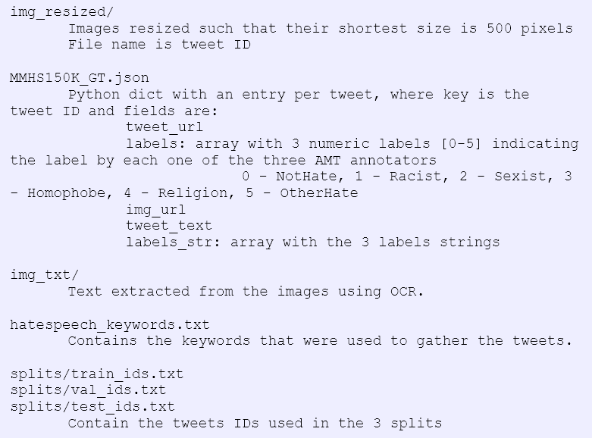
MMHS150k dataset:
Not hate tweets - 112, 845
Hate tweets - 36, 978
Category-Wise:
Racist : 11, 925
Sexist : 3, 495
Homophobic : 3, 870
Religion-based hate : 163
Other hate tweets : 5, 811

Slide 7
Methodology
Unimodal Treatment :
Image Feature Extractor - Pretrained Google Inception v3 architecture (Modifying its layers weights)
Tweet Text Feature Extractor – Single layer LSTM with GloVE
Image text – OCR to extract the text and LSTM

Slide 8
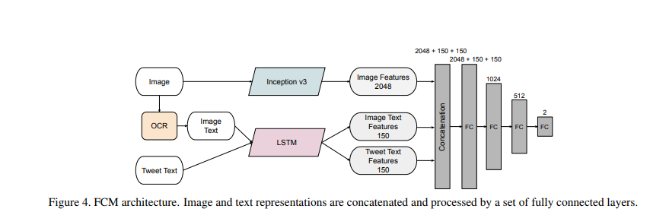
Multimodal Architectures :
FCM(Feature Concatenation Model) :
The image is fed to the Inception v3 architecture and the 2048 dimensional feature vector after the last average pooling layer is used as the visual representation.
Concatenation of image text , tweet text feature vectors with image feature vector.
Fully connected layers with batch normalization and ReLu layers until dimension is reduced to two, the number of classes, in the last classification layer

Slide 9
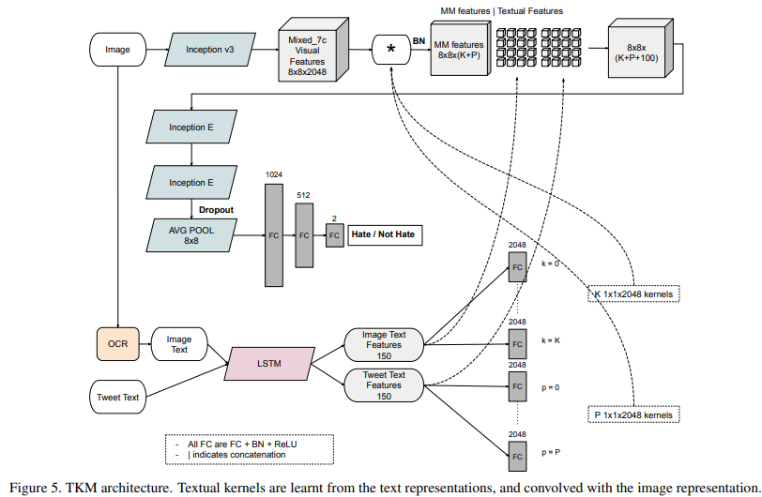
TKM( Textual Kernels Model ):
Aim: To capture interactions between the two modalities more expressively than concatenation models
Using tweet text encoded vector:
Learn Kt text dependent kernels using independent fully connected layers
Similarly for image text encoded vector, learning Kit kernels.
Then, the textual kernels are convolved with the visual feature map using the channel dimension at each spatial location, resulting in a multimodal feature map.
Then tweet text and image text encoded vectors are concatenated at each spatial dimension.

Slide 10
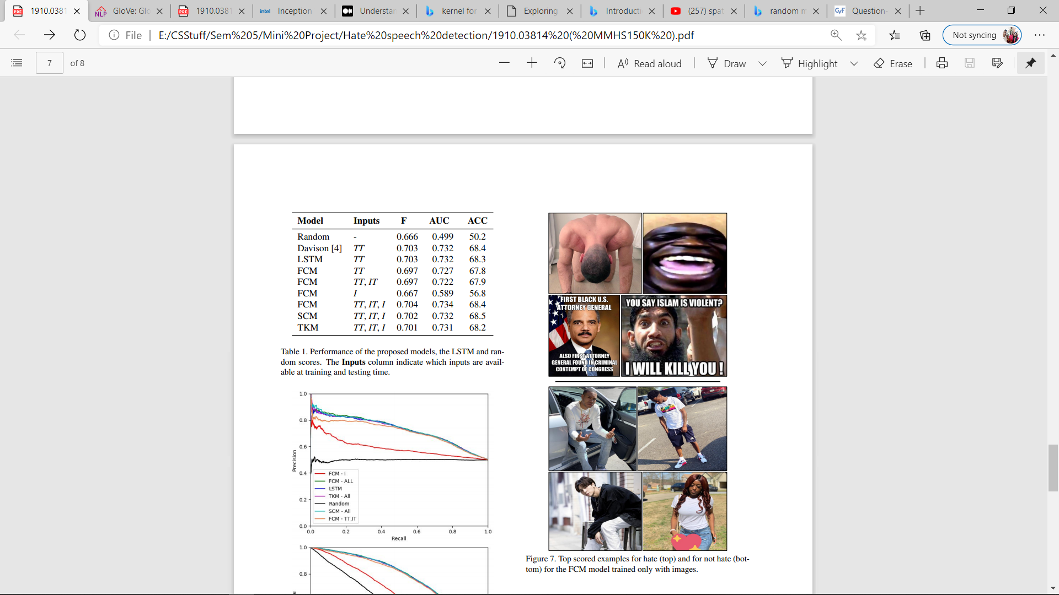
Results :
Despite the model trained only with images proves that they are useful for hate speech detection, the proposed multimodal models are not able to improve the detection compared to the textual models.
Conclusion :
Training different textual, visual and multimodal models with that data, and found out that, despite the fact that images are useful for hate speech detection, the multimodal models do not outperform the textual models.

Slide 11
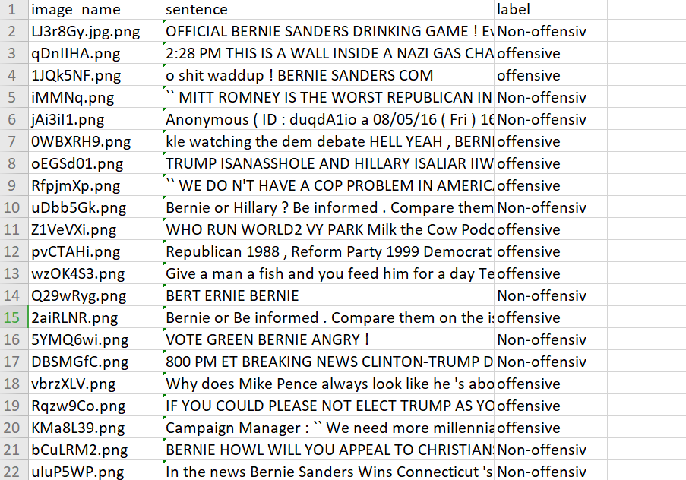
Research paper Link : https://www.aclweb.org/anthology/2020.trac-1.6.pdf Dataset link: https://drive.google.com/drive/folders/1ckOGoRmMwCEFo-k3UX7J2lnzg495WIS5
Multimodal Meme Dataset (MultiOFF) for Identifying Offensive Content in Image and Text
Dataset consists : Image Text Label

Slide 12
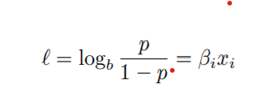
Baseline Models for Textual Data
Logistic Regression :If targeted class is linearly seperable
Bag of Words approadch has been used.
if p> threshold :offensive
else not offensive
Naive Bayes (NB)
A Deep Neural Network (DNN)
Stacked LSTM
Bidirectional LSTM (BiLSTM)

Slide 13
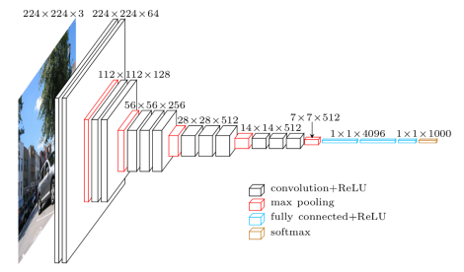
Baseline Model for Images
Convolution layers 3x3 filter with a stride 1 and always used same padding
Maxpool layer of 2x2 filter of stride 2. It follows this arrangement of convolution and max pool layers consistently throughout the whole architecture.
Instead of a fully connected layer, a Global Average Pooling layer has been used which later is connected to a Dense layer with the Sigmoid activation function to predict class probability.
The 16 in VGG16 refers to it has 16 layers that have weights.

Slide 14
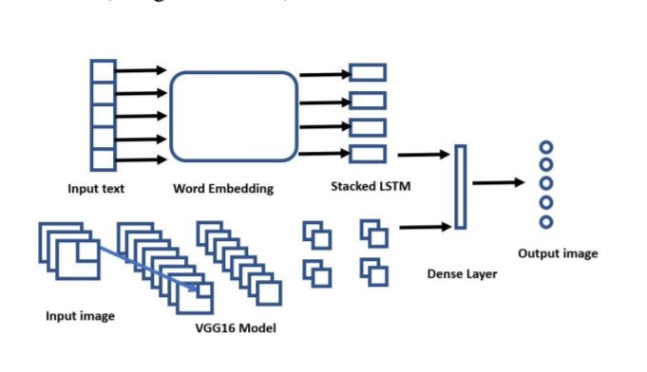
Multimodal Approach
Early fusion :
outputs of unimodal features extracted fro different data streams are integrated into single large vector

Slide 15
Analysis of Implemented Approach Hateful Memes Challenge 2020, SEP 22 Yuval Nirkin Assaf Rabinowitz Yoni Solel
Data Processing
Text embedding :SBERT
Image Embedding: MobileNetV3
Hypernetworks
Decoder

Slide 16
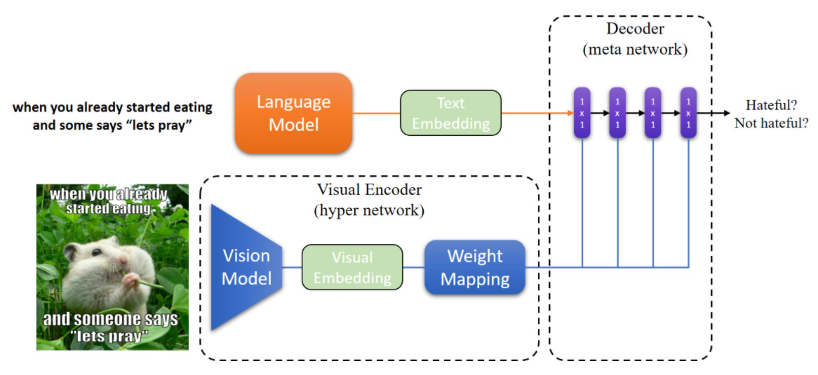
Model Description
The model based onto the hypernetwork.
The hypernetwork is a network that predicts the weights of another larger network.
The language model is based on SBert, it accepts the image's text and produces the text embedding Et.
The vision model accepts the image as input and produces the visual embedding Ev(768)
Ev is then fed to the weight mapping module, producing a set of weights θ.
The decoder is defined as a function f(Et,θ),that outputs the final binary prediction, is the image hateful or not hateful?

Slide 17
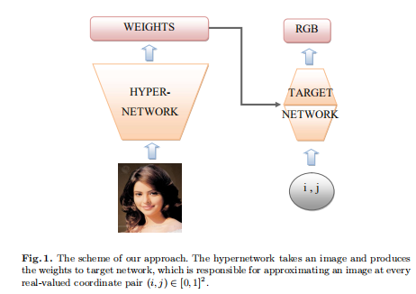
Hypernetwork functional image representation Sylwester Klocek, Łukasz Maziarka, Maciej Wołczyk, Jacek Tabor, Jakub Nowak, and Marek Śmieja
The aim of this paper is a proof of concept that one can effectively construct and train functional representations of images.
By a functional (or deep) representation of an image we understand a function (neural network) I : R² → R³
Which given a point (with arbitrary coordinates) (x, y) in the plane returns the point in [0, 1]³ representing the RGB values of the color of the image at (x, y).

Slide 18
Functional Representation of an Image
Hypernetwork model
Let f : [0, 1]² → [0, 255]³ be a function describing the image. To improve this discrete representation,the aim is at creating a function:
Tθ(i, j) = T((i, j), θ) : [0, 1]² × Θ → [0, 255]³
The approach to this task is by introducing a hypernetwork
Hϕ : (x∈ X) → (θ ∈ Θ) for an image x ∈ X returns weights θ to the corresponding target network Tθ.
To use the above model, we need to train the weights ϕ of the hypernetwork.
For this purpose, we minimize classical mean squared error (MSE) over training images.
More precisely, we take an input image x ∈ X and pass it to Hϕ.
The hypernetwork returns weights θ to target network Tθ.

Slide 19
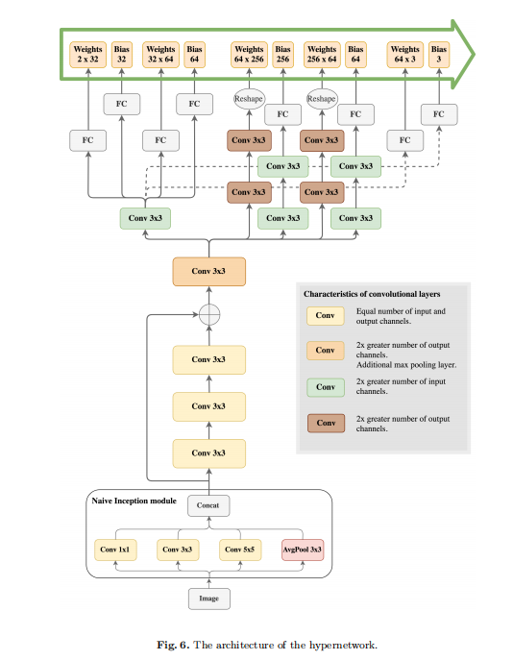
The first one is common and takes part in
generating weights for all of the target network’s layers.
Second part, on the other hand, contains several branches. Each branch calculates weights for a different layer of target network.
Common Layers:
The task of common layers is to extract meaningful features.
This extraction is performed using Naive Inception Module followed by four convolution layers.
Inception module leverages three different convolutions and average pooling.
It improves network accuracy and does not negatively influence training time.
Seprate Layers:
There are multiple branches responsible for converting extracted features into actual weights of target network.
Batch normalization is used after each layer of hypernetwork and ReLU is chosen as the activation function.
https://arxiv.org/pdf/1902.10404.pdf
https://ieeexplore.ieee.org/document/8014884

Slide 20
Proposed System
IMAGE Model
Fusion
Classifier
MEME
TEXT Model
HATEFUL
NON-HATEFUL

Slide 21
Functional Requirement
User can upload his own meme
System should be able to accept the meme and label it as hateful or not hateful
The system should be able to display the percentage of hate in the meme
The History window should show last 5 image’s result of classification
Non Functional Requirement
The window should be opened in less than 2 ms
It should be at least 70% accurate
Uploading time for an image should not exceed 1 minute
Size of the image should not exceed more than 500mb

Slide 22
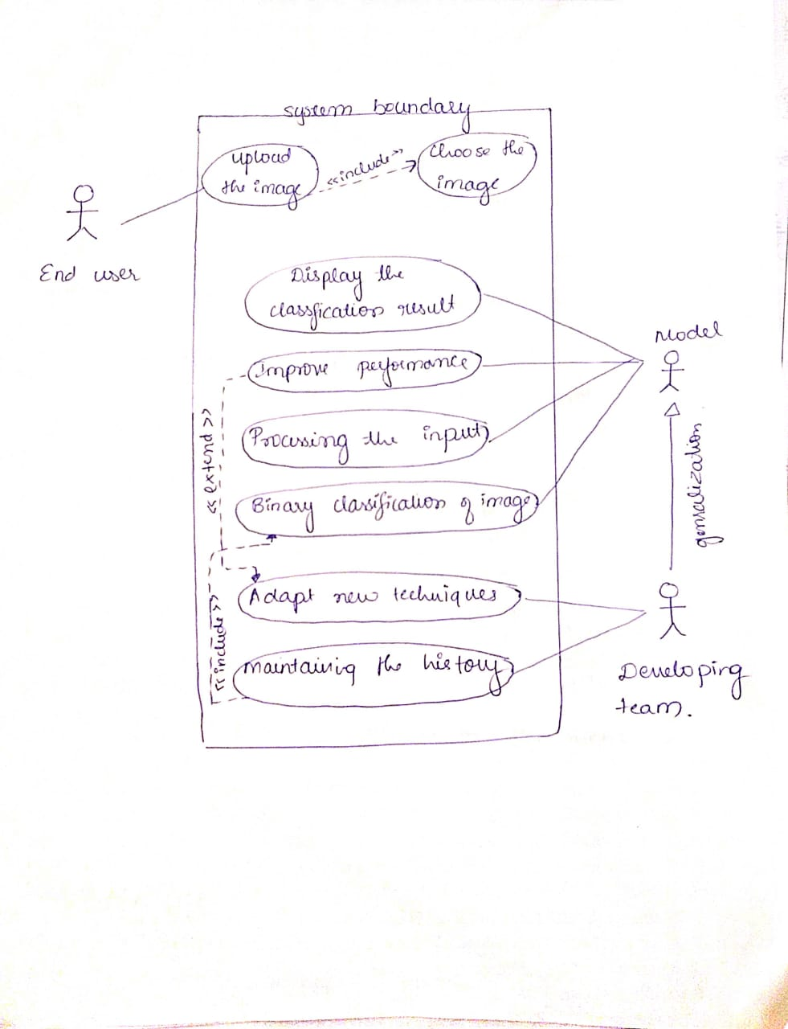
USE CASE DIAGRAM

